Slide 1
RecipeCove
Your place to find the best recipes!
Valerio Di Stefano - 1898728
Giuseppe Prisco - 1895709
“Engineering in Computer Science” Master’s Degree
Laboratory of Advanced Programming (2022/2023)

Slide 2
Index
Project Idea
System Infrastructure
Webapp container
Calendar container
CouchDB container
Nodemailer container
RabbitMQ container
User Stories & Mockups
Home Page
Search Results Page
Recipe Page
Ingredient Page
User Profile Page
Recipe Calendar Event
Chat-BOT (Menu)
Function Points Estimation & COCOMO II
Function Points
ILF & EIF
EI
EO & EQ
COCOMO II
SCRUM
Workflow Organization
Gantt Chart
Burndown Chart
Release Backlog
Sprint Reports
Sprint planning & Goals
Sprint summary
System Demo

Slide 3
Project Idea

Slide 4
Project Idea
We considered 3 main aspects for our final system:
Recipes and Ingredients discovery and bookmark
➡ We implemented a system to find exhaustive information for a wide range of recipes and maintained a favorite recipes list
Automated sub-systems to suggest recipes to the user and provide notifications
➡ We employed a Chat-BOT service to suggest recipes following a specific diet and implemented an automated email service
Place to save in-app events relating to recipes
➡ We allowed users to create a Calendar and reminders directly from the app

Slide 5
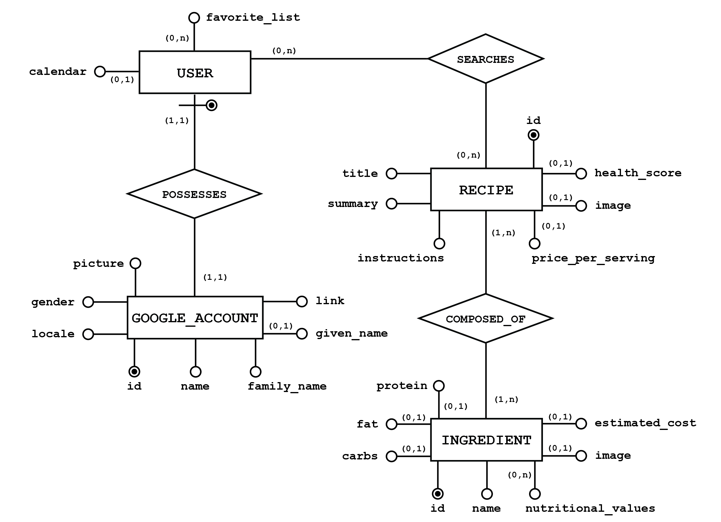

Slide 6
System Infrastructure

Slide 7
Webapp
Container
Features
Express js as routing and middleware framework
User Registration and Login
Management of the User Profile
Chat-BOT
Recipe discovery service
Ingredient information visualization
It is the main container of the system, based on Node.js, which contains the majority of the core functionalities of the application

Slide 8
Calendar Container
Features
Create a Google Calendar
Delete the Calendar from the system
Create an Event for a specific recipe and insert it in the Calendar
It is the container employed to serve the Google Calendar microservice

Slide 9
CouchDB Container
Features
Document-based database
Documents represented as Json files
Management of a replica set to provide replication
Store data related to users
It is the container used as the persistent layer of our system

Slide 10
Nodemailer Container
Features
Uses Nodemailer, a Node JS module
Sends emails to the gmail account of the registered users
Communicates with the Webapp container through the RabbitMQ container
This container is devoted to providing a mailing service

Slide 11
RabbitMQ Container
Features
Reliable Messaging Broker
Offers persistency, delivery of acknowledgements, publishers confirms and high availability
Middleware that provides multiple messaging protocols
This container manages messages exchanged between the Webapp and Nodemailer containers

Slide 12
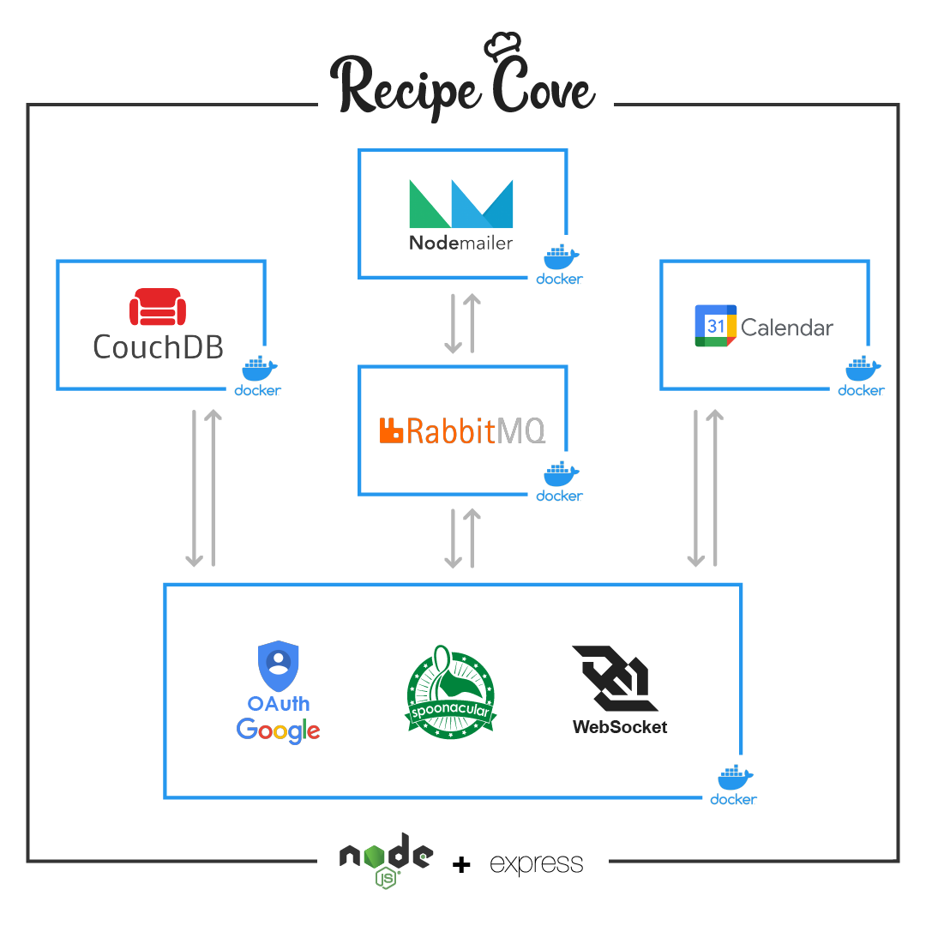

Slide 13
User Stories & Mockups

Slide 14
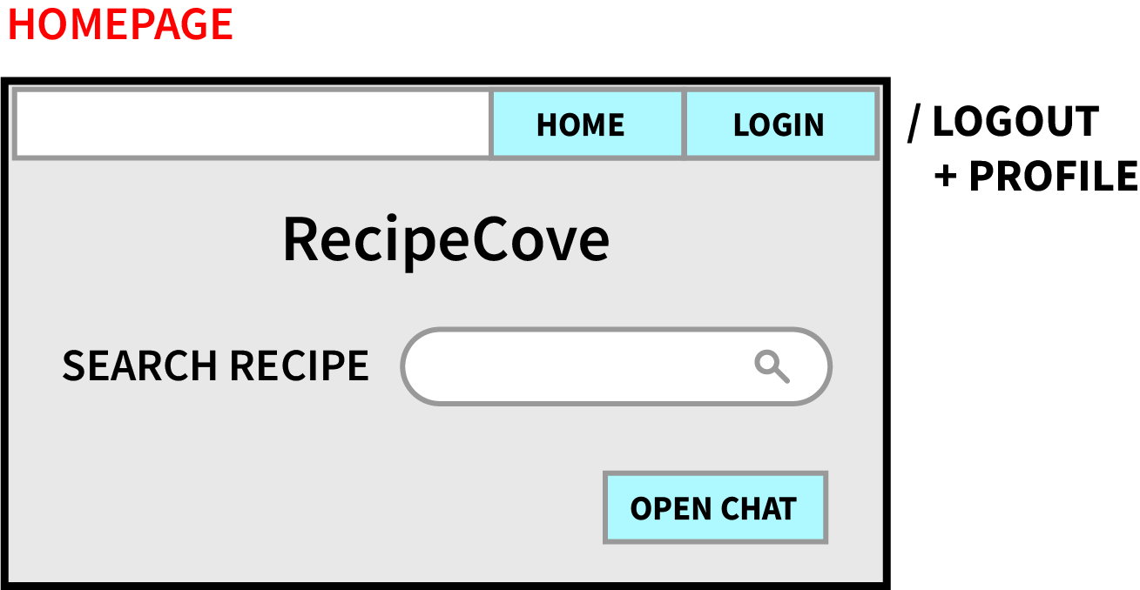
As a visitor, I want to be able to register in the website with an external account, so that I can use an existing Google account
As a visitor, I want to be able to search a recipe by its name, so that I can search only what interests me
As a visitor, I want to be able to check the suggested recipes for a specific diet, so that I can be inspired in what to prepare each day
As a registered user, I want to be able to perform the login, so that I can access other system’s functionalities
As a registered user, I want to be able to perform the logout, so that I can leave my information within the website

Slide 15
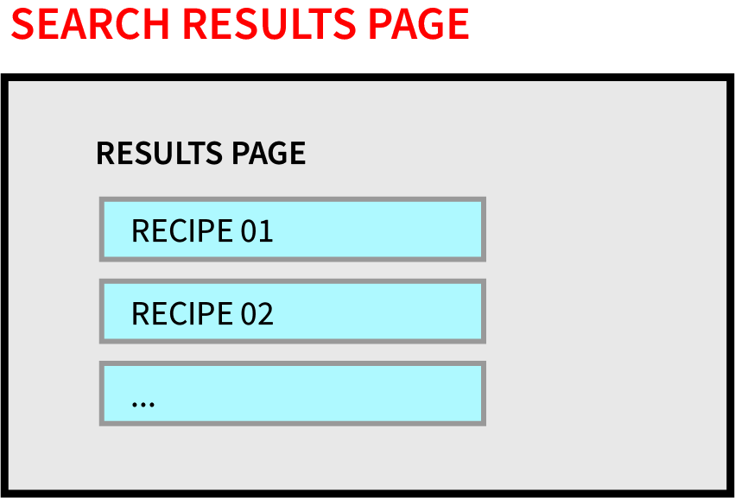
As a visitor, I want to be able to search a recipe by its name, so that I can search only what interests me
As a visitor, I want to be able to see the information of a recipe, so that I can learn more about it

Slide 16
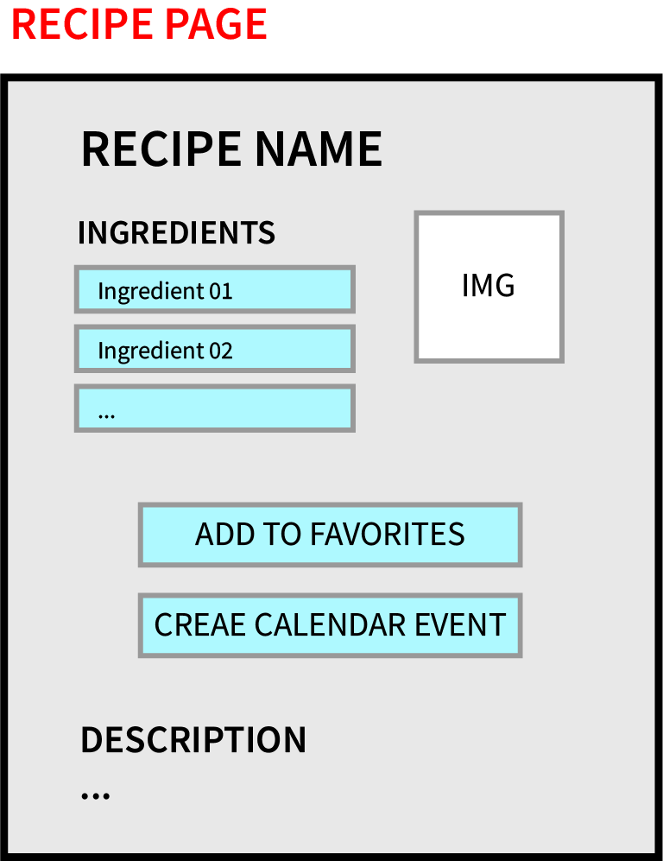
As a visitor, I want to be able to see the information of a recipe, so that I can learn more about it
As a visitor, I want to be able to see the information of an ingredient, so that I can know the details of each ingredient in a recipe
As a registered user, I want to be able to add an event to my Calendar, so that I can be reminded on a specific day to prepare a particular recipe
As a registered user, I want to be able to add a recipe to my favorite list, so that I can keep track of all the recipes I like

Slide 17
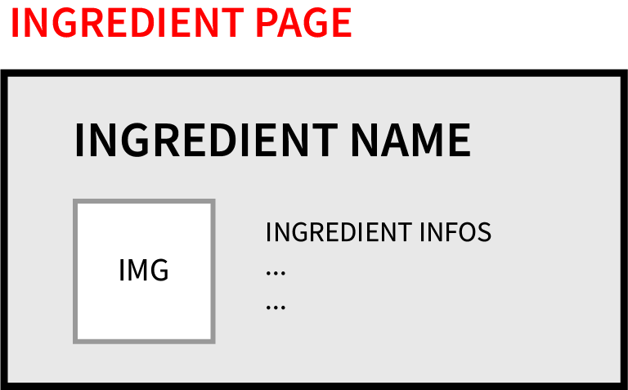
As a visitor, I want to be able to see the information of an ingredient, so that I can know the details of each ingredient in a recipe

Slide 18
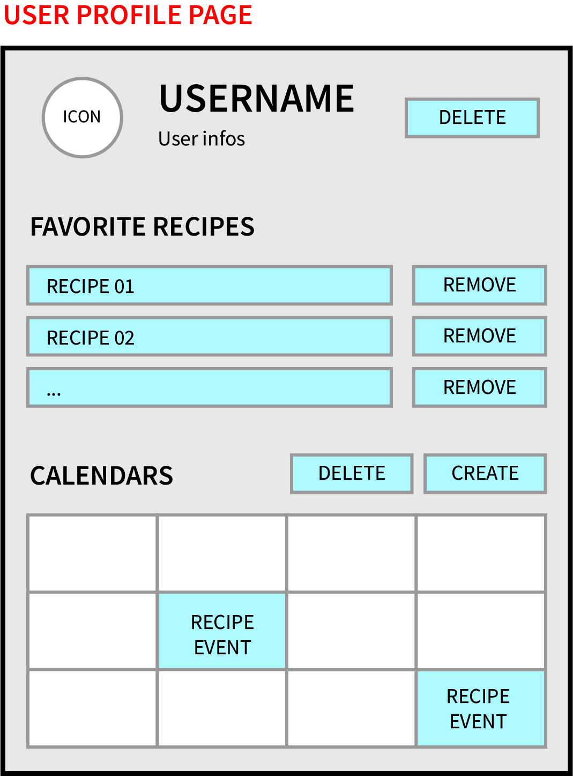
As a registered user, I want to be able to access my profile page, so that I can check my personal information
As a registered user, I want to be able to create a Calendar, so that I can populate it with events relating recipes
As a registered user, I want to be able to delete a Calendar, so that I can remove the data gathered within the website
As a registered user, I want to be able to remove a recipe from my favorite list, so that I can stop being interested in it
As a registered user, I want to be able to see my favorite list, so that I can check my current interests in recipes

Slide 19
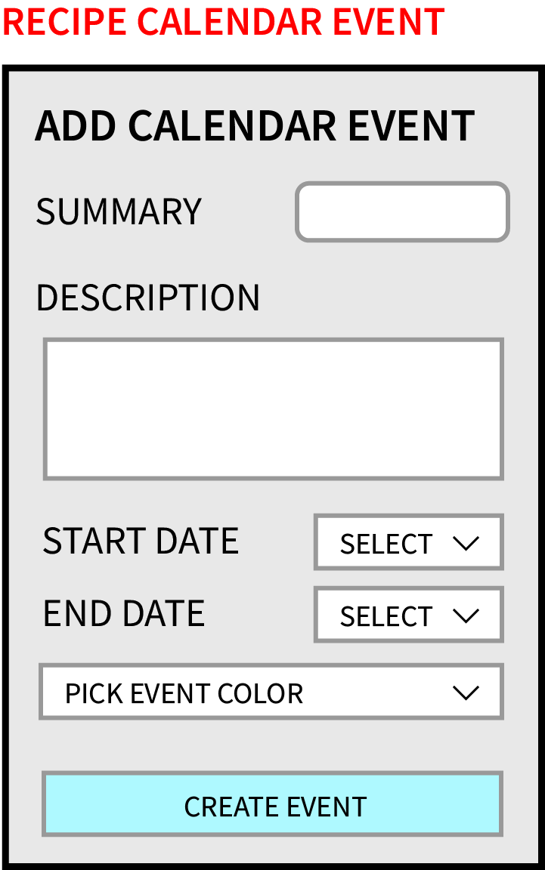
As a registered user, I want to be able to add an event to my Calendar, so that I can be reminded on a specific day to prepare a particular recipe

Slide 20
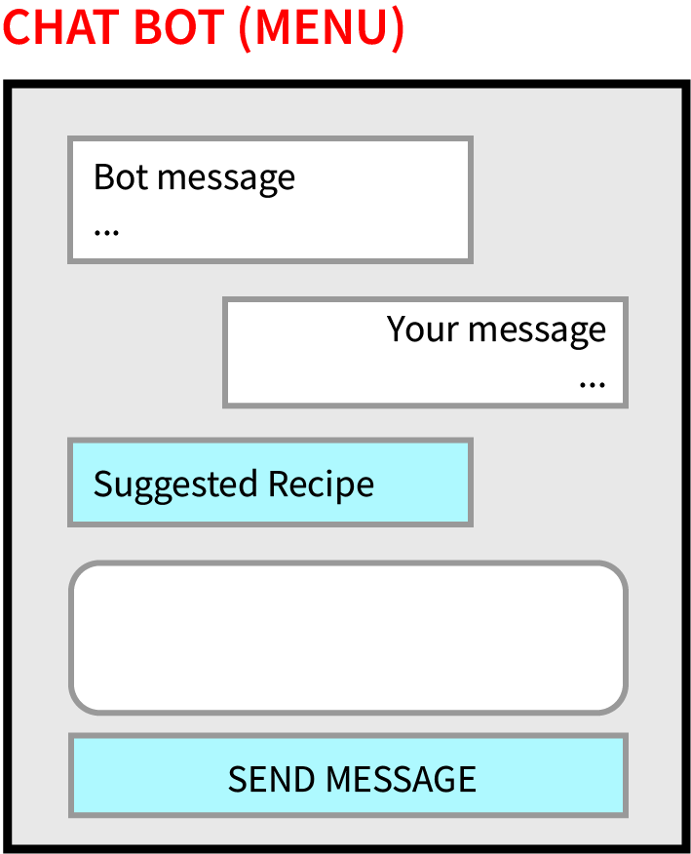
As a visitor, I want to be able to check the suggested recipes for a specific diet, so that I can be inspired in what to prepare each day

Slide 21
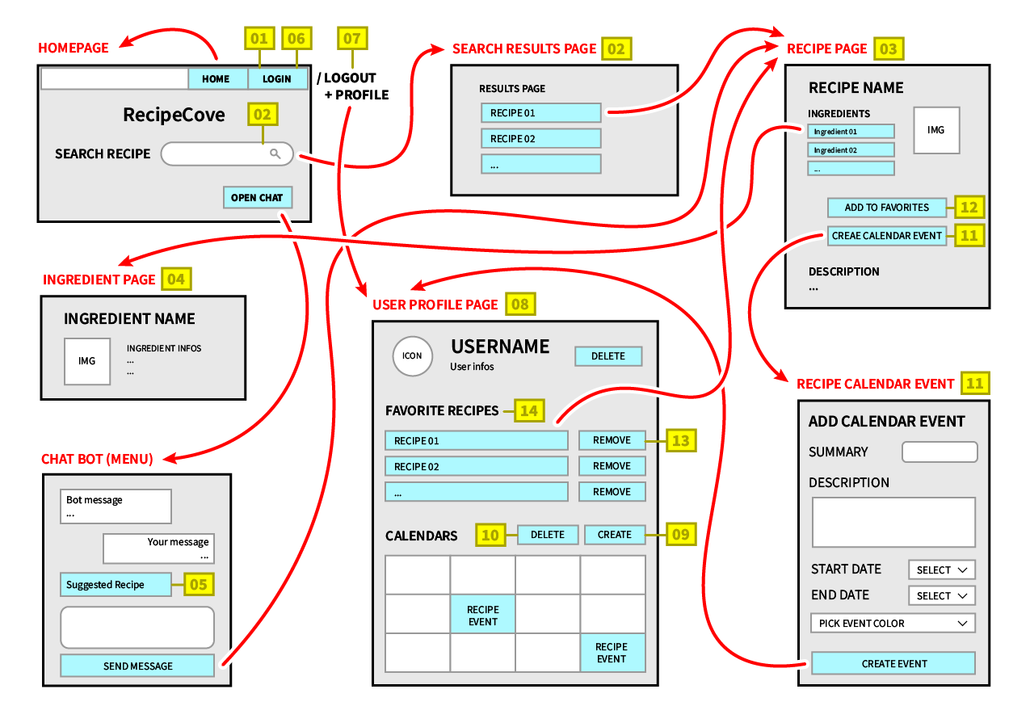

Slide 22
EPIC | USER STORY | PRIORITY | VALUE | RISK | ESTIMATE | RELEASE | ACCEPTANCE | DEPENDENCIES | NOTES
Registration | As a visitor, I want to be able to register in the website with an external account, so that I can use an existing Google account | 1 High | 1 High | 2 Med | LG | 1.x | Upon registering, the user will automatically be logged in the website, with the navbar reflecting the change by showing the updated info | Possession of a Google account | The user must accept Google Terms of Service and agree with the use of Google Calendar if he wants to interact with it directly in the website
Search recipes | As a visitor, I want to be able to search a recipe by its name, so that I can search only what interests me | 2 Med | 2 Med | 3 Med | MD | 3.x | The user will see a list of recipes matching the searched value | API service provider and related API Key | The user must avoid being too specific in the search terms since most recipes are particularly specific in their names
Show Recipe Information | As a visitor, I want to be able to see the information of a recipe, so that I can learn more about it | 2 Med | 1 High | 3 Med | LG | 3.x | The user will have specific information about the selected recipe, in the form of extended description of ingredients, instructions ecc | Depends on the user story in row #3 | The user should notice that each ingredient's card is interactive
Show Ingredient Information | As a visitor, I want to be able to see the information of an ingredient, so that I can know the details of each ingredient in a recipe | 4 Low | 3 Med | 4 Low | SM | 4.x | The user will see extended information about the selected ingredient | Depends on the user story in row #4
Suggest Recipes | As a visitor, I want to be able to check the suggested recipes for a specific diet, so that I can be inspired in what to prepare each day | 3 Med | 2 Med | 2 Med | LG | 4.x | The user will receive messages from the Chat-BOT in an asynchronous way | API service provider and related API Key

Slide 23
Login | As a registered user, I want to be able to perform the login, so that I can access other system's functionalities | 2 Med | 1 High | 2 Med | MD | 1.x | The user will notice the change in the navbar reflecting that he is logged in the website | Depends on the user story in row #2
Logout | As a registered user, I want to be able to perform the logout, so that I can leave my information within the website | 3 Med | 3 Med | 4 Low | SM | 1.x | The user will be redirected to the home page, noticing the possibility to login | Depends on the user story in row #7
Profile | As a registered user, I want to be able to access my profile page, so that I can check my personal information | 1 High | 1 High | 2 Med | LG | 1.x | The user will see all of his information in a detailed page, including his account data as well as his favorites recipes and his calendar | Depends on the user story in row #2 and #7 | After the first registration, this page may be relatively empty so it is suggested that the user interacts a little bit with the system first
Calendar Creation | As a registered user, I want to be able to create a Calendar, so that I can populate it with events relating recipes | 2 Med | 2 Med | 1 High | XLG | 2.x | Upon clicking the add button, the user will see the newly created calendar in the profile page | Depends on the user story in row #2 and #7 | Since a number of API calls to the Google Calendar API needs to be done, as well as an interaction with the database, a small amount of time is needed in order to correctly visualize the calendar in the profile page
Calendar Deletion | As a registered user, I want to be able to delete a Calendar, so that I can remove the data gathered within the website | 3 Med | 3 Med | 4 Low | LG | 2.x | Upon clicking the delete button, the user will notice that the calendar will no longer be visible in the profile page | Depends on the user story in row #10 | As before, a small amount of time may be needed in order to properly update the profile page
Add Event | As a registered user, I want to be able to add an event to my Calendar, so that I can be reminded on a specific day to prepare a particular recipe | 1 High | 2 Med | 3 Med | MD | 3.x | After filling the required form information, the user will be redirected to his profile page and see the newly added event | Depends on the user story in row #10 and #4 | If the event is added for days not displayed in the current month, the user needs to scroll the various months of the calendar to check the new event

Slide 24
Add Recipe to Favorites | As a registered user, I want to be able to add a recipe to my favorite list, so that I can keep track of all the recipes I like | 2 Med | 1 High | 3 Med | MD | 4.x | When the user is logged in, after clicking on the button to add the current recipe to his favorite list, he can see his list updated correctly in his profile | Depends on the user story in row #7 and #4 | In order to provide the best navigation for the user, after he adds a recipe to his favorite list, he will not automatically be redirected to the profile, remaining at the current visited page
Remove Recipe from Favorites | As a registered user, I want to be able to remove a recipe from my favorite list, so that I can stop being interested in it | 4 Low | 3 Med | 4 Low | MD | 4.x | The user will see his favorite list automatically updated in his profile, with the selected recipe removed from the list | Depends on the user story in row #9 | It follows the same principles of the previous user story
Show Favorites List | As a registered user, I want to be able to see my favorite list, so that I can check my current interests in recipes | 2 Med | 1 High | 2 Med | SM | 4.x | Once entering the profile, the user will be able to correctly see the displayed favorite list, at the right-hand side of the page | Depends on the user story in row #9
Delete Account | As a registered user, I want to be able to delete my personal account, so that I can remove everything related to it from the website | 2 Med | 2 Med | 2 Med | MD | 1.x | The user will automatically be redirected to the home page, in which he has the ability to register to the website again | Depends on the user story in row #9 | When deleting the account from the website, the user will not be automatically have the consent removed from the services he agreed before (Google account and Google Calendar). In order to do so, he has to enter his personal area in his Google account and remove the consents manually
Mail Notification | As a visitor, I want to be able to receive a mail notification when registering, so that I can know if the registration process has succeeded | 2 Med | 3 Med | 2 Med | LG | 5.x | The user will receive a mail to the Google account used to register in the system | Depends on the user story in row #2 | The user may not have the notifications activated for gmail, so in order to see the feedback he may directly enter the app and check the latest mails

Slide 25
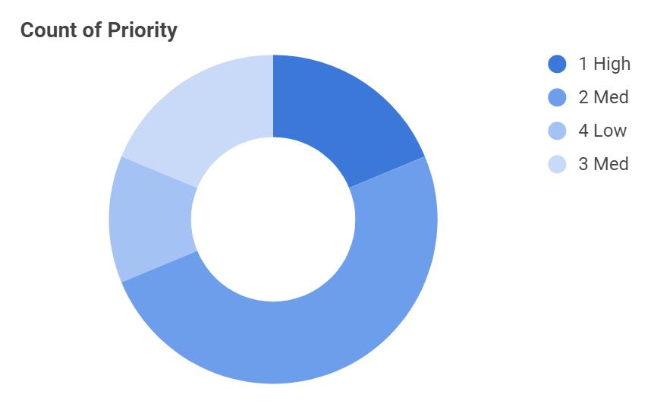
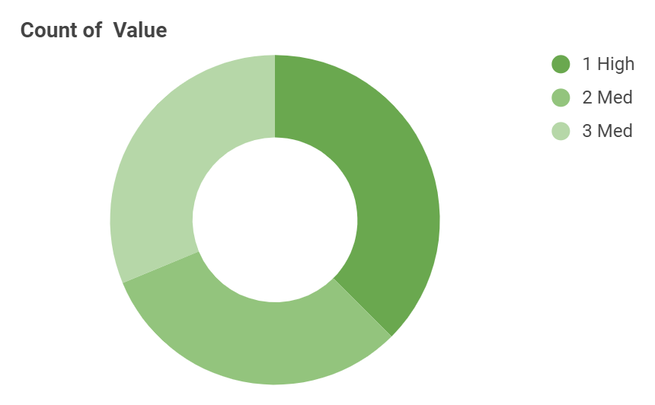
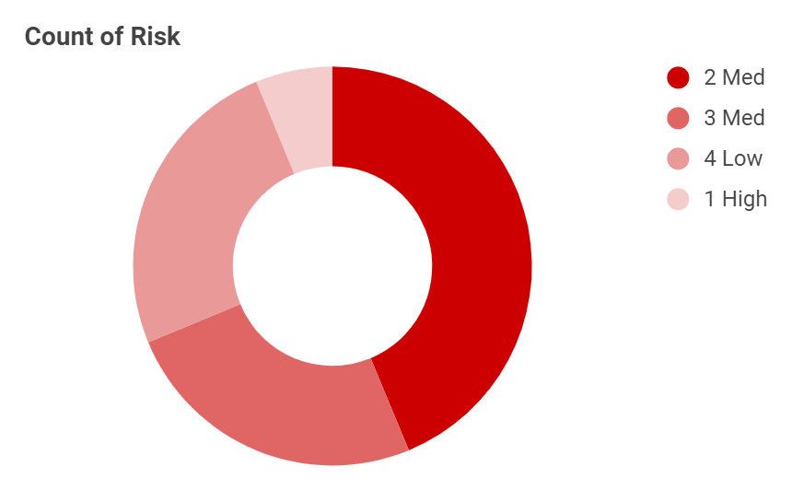
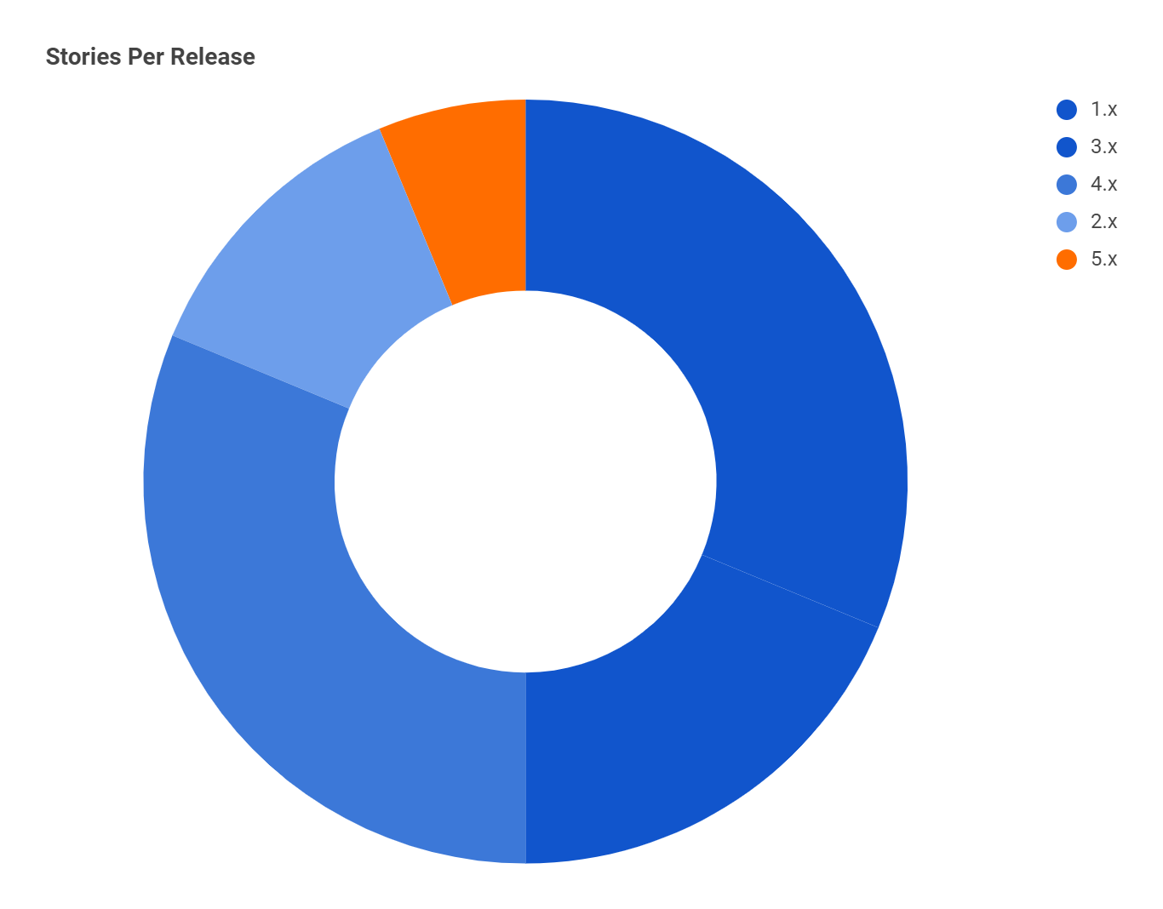
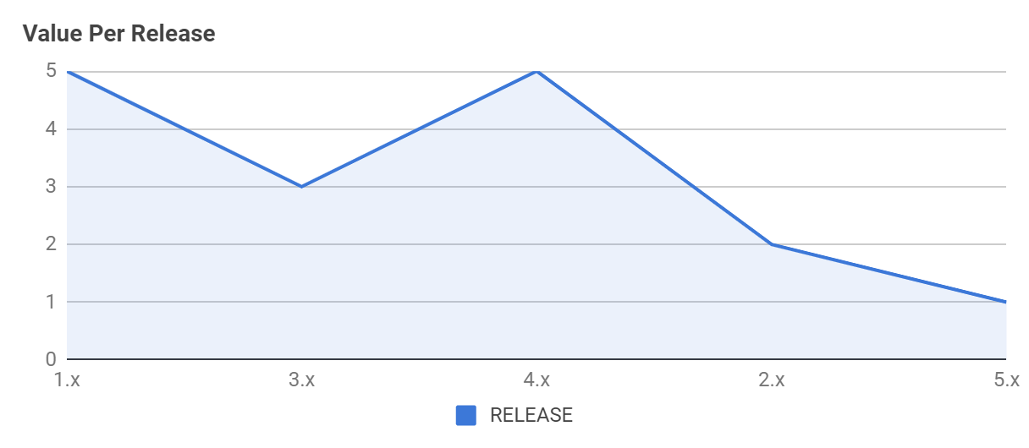
Stories per Release

Slide 26
Function Points Estimation & COCOMO II

Slide 27
ILF & EIF
Total FP = 22
Starting from the definition of the Internal Logical Files (ILF) and External Interface Files (EIF), we identified:
An ILF for the users, with 1 RET and 10 DET (id, name, given name, family name, link, picture, gender, locale, favorites list, calendar information) ➡ 7FP
An EIF for the google account information, with 1 RET and 8 DET ➡ 5FP
An EIF for the recipes information, with 1 RET and 7 DET ➡ 5FP
An EIF for the ingredient information, with 1 RET and 8 DET ➡ 5FP

Slide 28
External Inputs (EI)
Total FP = 22
For data coming from outside the application boundaries we identified the following External Inputs (EI):
An EI for inserting a new user, with 2 FTR and 10 DET ➡ 4FP
An EI for the login of a user, with 1 FTR and 1 DET ➡ 3FP
An EI for deleting a user, with 1 FTR and 10 DET ➡ 3FP
An EI for creating a new calendar for a user, with 1 FTR and 1 DET ➡ 3FP
An EI for deleting a calendar for a user, with 1 FTR and 1 DET ➡ 3FP
An EI for adding a recipe to the favorite list, with 1 FTR and 1 DET ➡ 3FP
An EI for deleting a recipe from the favorite list, with 1 FTR and 1 DET ➡ 3FP

Slide 29
External Outputs (EO)
Total FP = 8
For the data sent outside the application boundaries, which modifies or alters an ILF, we described these External Outputs (EO):
An EO for preparing and sending an email to the registered user, with 1 FTR and 2 DET ➡ 4FP
An EO for adding an event to calendar and visualize it, with 1 FTR and 1 DET ➡ 4FP

Slide 30
External Inquiries (EQ)
Total FP = 13
As far as the data sent outside the application boundaries, which however is not modified nor provides derived data, we identified the following External Inquiries (EQ):
An EQ for the visualization of the profile of a user, with 2 FTR and 7 DET ➡ 4FP
An EQ for the visualization of the favorite list, with 1 FTR and 1 DET ➡ 3FP
An EQ to visualize a recipe’s information, with 1 FTR and 7 DET ➡ 3FP
An EQ to visualize an ingredient’s information, with 1 FTR and 8 DET ➡ 3FP

Slide 31



COCOMO II
Function Points
The estimated amount of total function points is:
65 FP
Lines of Code
Using Javascript as the programming language:
3445 SLOC
Estimated Time
Using the COCOMO II methodology:
6.1 person-months

Slide 32
No. | Module | Function Name | Description | Type | DET | RET / FTR | Complexity | FP | Adjust % | FP adjusted
1 | User | Users information | Information about the users | ILF | 10 | 1 | Low | 7 |  | 7
2 | Google account | Google account information | Information about the Google account | EIF | 8 | 1 | Low | 5 |  | 5
3 | Recipe | Recipes information | Information about the recipes | EIF | 7 | 1 | Low | 5 |  | 5
4 | Ingredient | Ingredients information | Information about the ingredients | EIF | 8 | 1 | Low | 5 |  | 5
5 | User | Insert User | Insert a new user into the database | EI | 10 | 2 | Average | 4 |  | 4
6 | User | Login User | Login the user into the system | EI | 1 | 1 | Low | 3 |  | 3
7 | User | Delete User | Delete the user from the database | EI | 10 | 1 | Low | 3 |  | 3
8 | Calendar | Create Calendar | Create a new Calendar for a user | EI | 1 | 1 | Low | 3 |  | 3
9 | Calendar | Delete Calendar | Delete a Calendar for a User | EI | 1 | 1 | Low | 3 |  | 3
10 | Recipe | Add Recipe to favorites | Add a Recipe to the favorites list | EI | 1 | 1 | Low | 3 |  | 3
11 | Recipe | Remove Recipe from favorites | Remove a Recipe from the favorites list | EI | 1 | 1 | Low | 3 |  | 3
12 | User | Send Mail | The system sends a confirmation email to the User the registers | EO | 2 | 1 | Low | 4 |  | 4
13 | Calendar | Add Event to Calendar | Add a new Event to a Calendar | EO | 1 | 1 | Low | 4 |  | 4
14 | User | Display User Profile | Visualize the Profile of a User | EQ | 7 | 2 | Average | 4 |  | 4
15 | User | Display Favorite List | Visualize the favorite list of a User | EQ | 1 | 1 | Low | 3 |  | 3
16 | Recipe | Display Recipes information | Visualize a Recipe's information | EQ | 7 | 1 | Low | 3 |  | 3
17 | Ingredient | Display Ingredients information | Visualize a Ingredient's information | EQ | 8 | 1 | Low | 3 |  | 3

Slide 33
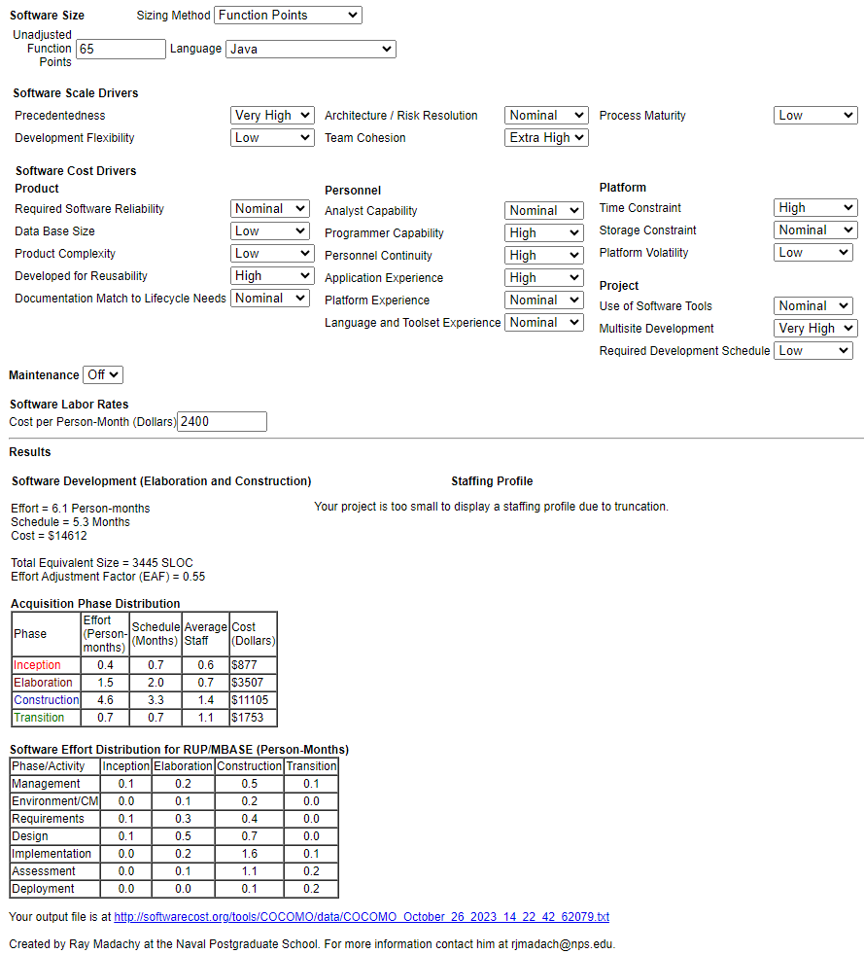
startCOCOMO, 1 MonteCarlo, MonteCarlo_Off AutoCalculate, On size_type, Function Points function_points, 65 language, Java prec, Very_High flex, Low rely, Nominal data, Low cplx, Low ruse, High docu, Nominal resl, Nominal team, Extra_High acap, Nominal pcap, High pcon, High apex, High pexp, Nominal ltex, Nominal pmat, Low time, High stor, Nominal pvol, Low tool, Nominal site, Very_High sced, Low software_maintenance, Off software_labor_cost_per_PM, 2400 software_EAF, 0.55 size_exponent, 1.0677 schedule_exponent, 0.312 software_effort, 6.1 software_schedule, 5.3

Slide 34
SCRUM

Slide 35
Workflow organization
Valerio Di Stefano, the Product Owner ➡ Define the features of the final product, decide the release dates and adjust the features and their priorities at each iteration
Giuseppe Prisco, the SCRUM Master ➡ Manage the project and enforce Scrum values and practices, remove any impediments and ensure that the team is fully functional and productive
Valerio Di Stefano & Giuseppe Prisco, the Team ➡ Each member is specialized in different functions, team members were full-time and self-organized throughout the development phases

Slide 36
WORK BREAKDOWN STRUCTURE | TASK TITLE | TASK OWNER | AMOUNT OF WORK IN HOURS |  |  | SPRINT | START DATE | DUE DATE | DURATION | PCT OF TASK COMPLETE
 |  |  | ESTIMATE | COMPLETED | REMAINING
1 | Project Conception and Documentation |  | 56 | 56 | 0 |  |  |  |  | 100%
1.1 | Project Functionalities | V | 10 | 10 | 0 | 1 | 9/20/2023 | 9/23/2023 | 4 | 100%
1.2 | User Stories | V | 10 | 10 | 0 | 1 | 9/23/2023 | 9/25/2023 | 3 | 100%
1.3 | LoFi Mockups | V | 12 | 12 | 0 | 1 | 9/25/2023 | 9/29/2023 | 5 | 100%
1.4 | Function Points Estimate | G | 8 | 8 | 0 | 1 | 9/25/2023 | 9/26/2023 | 2 | 100%
1.5 | COCOMO II | G | 7 | 7 | 0 | 1 | 9/27/2023 | 9/29/2023 | 3 | 100%
1.6 | ER schema | V | 4 | 4 | 0 | 2 | 9/29/2023 | 9/29/2023 | 1 | 100%
1.7 | Software architecture schema | V | 5 | 5 | 0 | 2 | 9/30/2023 | 10/1/2023 | 2 | 100%
2 | System Configuration and Basic Functionalities |  | 37 | 37 | 0 |  |  |  |  | 100%
2.1 | Registration with a Google Account | G | 12 | 12 | 0 | 2 | 10/1/2023 | 10/4/2023 | 4 | 100%
2.2 | Login | G | 6 | 6 | 0 | 2 | 10/4/2023 | 10/5/2023 | 2 | 100%
2.3 | Logout | G | 3 | 3 | 0 | 2 | 10/5/2023 | 10/5/2023 | 1 | 100%
2.4 | Delete Account | G | 6 | 6 | 0 | 2 | 10/6/2023 | 10/7/2023 | 2 | 100%
2.5 | Profile | G | 10 | 10 | 0 | 2 | 10/8/2023 | 10/10/2023 | 3 | 100%

Slide 37
3 | Development of Core Functionalities |  | 54 | 54 | 0 |  |  |  |  | 100%
3.1 | Create Calendar | G | 16 | 16 | 0 | 3 | 10/11/2023 | 10/14/2023 | 4 | 100%
3.2 | Delete Calendar | G | 12 | 12 | 0 | 3 | 10/14/2023 | 10/16/2023 | 3 | 100%
3.3 | Search Recipes | V | 8 | 8 | 0 | 4 | 10/17/2023 | 10/18/2023 | 2 | 100%
3.4 | Show Recipes Information | V | 12 | 12 | 0 | 4 | 10/18/2023 | 10/21/2023 | 4 | 100%
3.5 | Add Event to Calendar | G | 6 | 6 | 0 | 4 | 10/18/2023 | 10/19/2023 | 2 | 100%
4 | Development of additional minor Functionalities |  | 20 | 20 | 0 |  |  |  |  | 100%
4.1 | Show Ingredient Information | V | 4 | 4 | 0 | 5 | 10/22/2023 | 10/23/2023 | 2 | 100%
4.2 | Suggest Recipes | G | 8 | 8 | 0 | 5 | 10/22/2023 | 10/24/2023 | 3 | 100%
4.3 | Add Recipe to Favorites | V | 4 | 4 | 0 | 5 | 10/23/2023 | 10/23/2023 | 1 | 100%
4.4 | Remove Recipe from Favorites | V | 3 | 3 | 0 | 5 | 10/24/2023 | 10/24/2023 | 1 | 100%
4.5 | Show Favorite Recipes | V | 1 | 1 | 0 | 5 | 10/24/2023 | 10/24/2023 | 1 | 100%
5 | Finalization of the Project |  | 23 | 23 | 0 |  |  |  |  | 100%
5.1 | Mail Notification | V | 12 | 12 | 0 | 6 | 10/25/2023 | 10/27/2023 | 3 | 100%
5.2 | GUI for Home, profile, recipes, ingredients page | V | 7 | 7 | 0 | 6 | 10/27/2023 | 10/28/2023 | 2 | 100%
5.3 | GUI for add event to calendar and error page | G | 4 | 4 | 0 | 6 | 10/27/2023 | 10/28/2023 | 2 | 100%

Slide 38
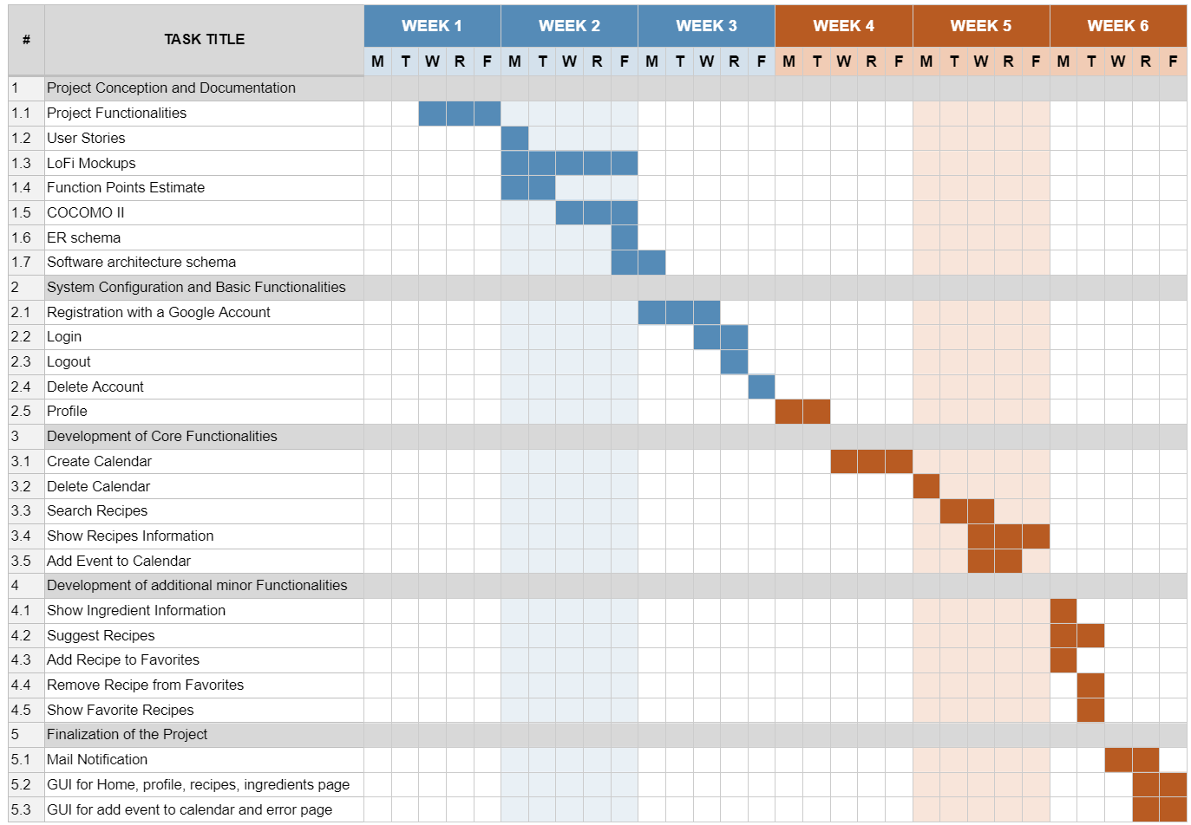

Slide 39
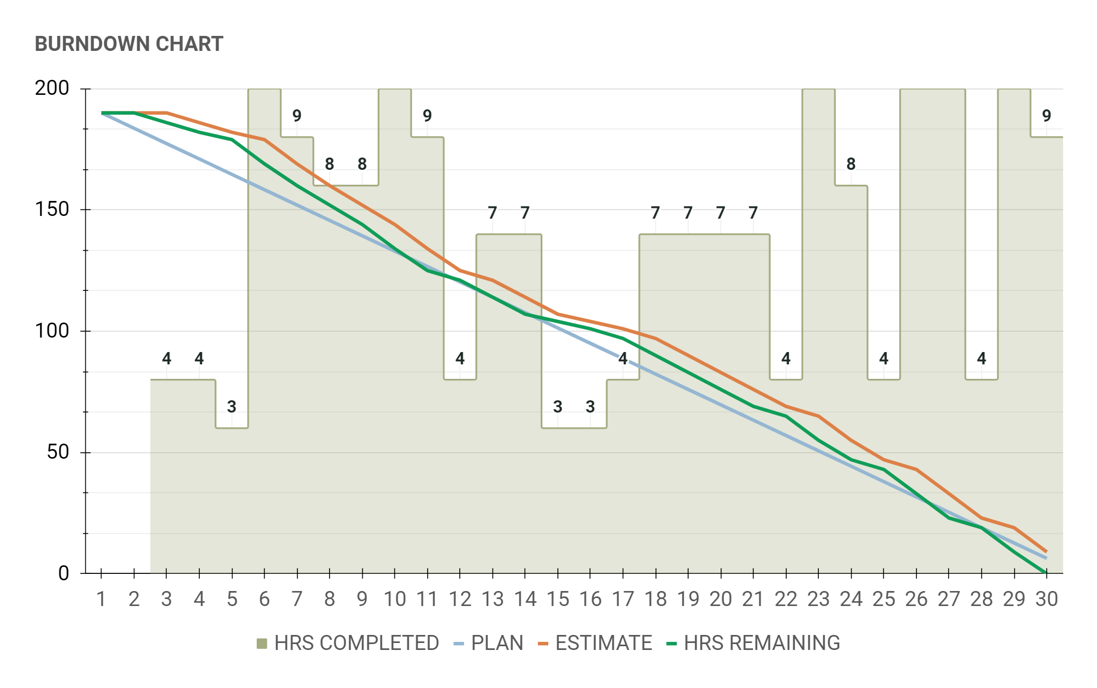
DAY | 1 | 2 | 3 | 4 | 5 | 6 | 7 | 8 | 9 | 10 | 11 | 12 | 13 | 14 | 15 | 16 | 17 | 18 | 19 | 20 | 21 | 22 | 23 | 24 | 25 | 26 | 27 | 28 | 29 | 30
PLAN | 190 | 184 | 177 | 171 | 165 | 158 | 152 | 146 | 139 | 133 | 127 | 120 | 114 | 108 | 101 | 95 | 89 | 82 | 76 | 70 | 63 | 57 | 51 | 44 | 38 | 32 | 25 | 19 | 13 | 6
ESTIMATE | 190 | 190 | 190 | 186 | 182 | 179 | 169 | 160 | 152 | 144 | 134 | 125 | 121 | 114 | 107 | 104 | 101 | 97 | 90 | 83 | 76 | 69 | 65 | 55 | 47 | 43 | 33 | 23 | 19 | 9
HRS COMPLETED |  |  | 4 | 4 | 3 | 10 | 9 | 8 | 8 | 10 | 9 | 4 | 7 | 7 | 3 | 3 | 4 | 7 | 7 | 7 | 7 | 4 | 10 | 8 | 4 | 10 | 10 | 4 | 10 | 9
HRS REMAINING | 190 | 190 | 186 | 182 | 179 | 169 | 160 | 152 | 144 | 134 | 125 | 121 | 114 | 107 | 104 | 101 | 97 | 90 | 83 | 76 | 69 | 65 | 55 | 47 | 43 | 33 | 23 | 19 | 9 | 0

Slide 40
PRIORITY | SPRINT | FUNCTIONALITY | TASK TITLE | TASK DESCRIPTION | TASK OWNER | WORK ESTIMATE IN HOURS | STATUS
High | 1 | Project Conception and Documentation | Project Functionalities | Definition of the major functionalities of our project | V | 10 | Completed
High | 1 | Project Conception and Documentation | User Stories | Definition of the user stories of the system | V | 10 | Completed
Medium | 1 | Project Conception and Documentation | LoFi Mockups | Creation of the Low-Fidelity mockups of the the pages of our system | V | 12 | Completed
Medium | 1 | Project Conception and Documentation | Function Points Estimate | Estimation of the function points | G | 8 | Completed
Medium | 1 | Project Conception and Documentation | COCOMO II | Utilization of the COCOMO II method | G | 7 | Completed
Low | 2 | Project Conception and Documentation | ER schema | Creation of the ER-schema of our system | V | 4 | Completed
Low | 2 | Project Conception and Documentation | Software architecture schema | Creation of the schema of our system's architecture | V | 5 | Completed
High | 2 | System Configuration and Basic Functionalities | Registration with a Google Account | Creation of the functionality to register with a Google account in our system | G | 12 | Completed
Medium | 2 | System Configuration and Basic Functionalities | Login | Creation of the functionality to login in our system | G | 6 | Completed
Medium | 2 | System Configuration and Basic Functionalities | Logout | Creation of the functionality to logout from our system | G | 3 | Completed
Medium | 2 | System Configuration and Basic Functionalities | Delete Account | Managing the deletion of an account from the system | G | 6 | Completed
High | 2 | System Configuration and Basic Functionalities | Profile | Managing the information to be shown in the user profile | G | 10 | Completed

Slide 41
Medium | 3 | Development of Core Functionalities | Create Calendar | Creation of the functionality to create a Calendar directly in our system | G | 16 | Completed
Medium | 3 | Development of Core Functionalities | Delete Calendar | Creation of the functionality to delete a Calendar directly in our system | G | 12 | Completed
Medium | 4 | Development of Core Functionalities | Search Recipes | Creation of the functionality to search for recipes by name with an external API | V | 8 | Completed
Medium | 4 | Development of Core Functionalities | Show Recipes Information | Creation of the functionality to get the information for recipes with an external API | V | 12 | Completed
High | 4 | Development of Core Functionalities | Add Event to Calendar | Creation of the functionality to add an event to a Calendar directly in our system | G | 6 | Completed
Low | 5 | Development of additional minor Functionalities | Show Ingredient Information | Creation of the functionality to get the information for ingredients with an external API | V | 4 | Completed
Medium | 5 | Development of additional minor Functionalities | Suggest Recipes | Creation of the functionality to get the suggested recipes for a specific diet with a Chat-BOT | G | 8 | Completed
Medium | 5 | Development of additional minor Functionalities | Add Recipe to Favorites | Creation of the functionality to add recipes to a favorite list | V | 4 | Completed
Low | 5 | Development of additional minor Functionalities | Remove Recipe from Favorites | Creation of the functionality to delete recipes from the favorite list | V | 3 | Completed
Medium | 5 | Development of additional minor Functionalities | Show Favorite Recipes | Creation of the functionality to show all the recipes of the favorite list in the user profile | V | 1 | Completed
Medium | 6 | Finalization of the Project | Mail Notification | Creation of the functionality to send an email to the Google account used during registration | V | 12 | Completed
Low | 6 | Finalization of the Project | GUI for Home, profile, recipes, ingredients page | Improved the GUI for the Home, profile, recipes and ingredients pages | V | 7 | Completed
Low | 6 | Finalization of the Project | GUI for add event to calendar and error page | Improved the GUI for the add event to calendar and error pages | G | 4 | Completed

Slide 42
Sprint Reports

Slide 43
Sprint Organization
The work for the project has been organized in 6 different sprints ➡ The team selected items from the product backlog and collaboratively identified the tasks:
At the end of each working day ➡ 10-15 minutes discord call to reorganize what has been done, what has been accomplished and what was not working
At the end of each sprint ➡ presentation of what has been done during the sprint, showing a brief demo of the newly accomplished functionalities

Slide 44
Sprint Planning & Goals - General Summary
Sprint #1
Basic Functionalities & Documentation
Sprint #2
System Configuration & Basic Functionalities
Sprint #3
First set of Core Functionalities
Sprint #4
Second set of Core Functionalities
Sprint #5
Additional Minor Functionalities
Sprint #6
Last Functionalities & Polishing of the GUI

Slide 45





Sprint Planning & Goals - General Summary
SPRINT 1
SPRINT 3
SPRINT 5
System Configuration
Second set of Core Functionalities
Last Functionalities & Polishing of GUI
Documentation
First set of Core Functionalities
Additional Minor Functionalities
SPRINT 2
SPRINT 4
SPRINT 6

Slide 46
Sprint 1
Name |  | Initial Sprint |  |  |  | 0
Goal |  | Define basic functionalities and documentation |  | Duration | 8 working days
Process improvement |  | Improve the estimation of the work |  | Things | 5 things
Start Date |  | 20/09/2023 |  | Story Points | 47 points
End Date |  | 29/09/2023 |  |  |  | days left
Sprint Metrics
Things Planned |  | 5 | Key Achievements | The task plan for this sprint was correctly completed. The general conceptions and the documentations of the Project have been defined.
Points Planned |  | 47
Things done: |  | 5
Things left: |  | 0 | Performance Summary | The tasks we identified requested the same amount of hours we initially planned.
Story Points done |  | 47
Story Points left: |  | 0
Sprint Backlog
Things (5) | Type | Story Points (47) | Description
Project Functionalities | task | 10 | Definition of the major functionalities of our project
User Stories | task | 10 | Definition of the user stories of the system
LoFi Mockups | task | 12 | Creation of the Low-Fidelity mockups of the the pages of our system
Function Points Estimate | task | 8 | Estimation of the function points
COCOMO II | task | 7 | Utilization of the COCOMO II method

Slide 47
Sprint 2
Name |  | Second Sprint |  |  |  | 0
Goal |  | System Configuration and Basic Functionalities |  | Duration | 8 working days
Process improvement |  | Improve the commit quality |  | Things | 7 things
Start Date |  | 29/09/2023 |  | Story Points | 46 points
End Date |  | 10/10/2023 |  |  |  | days left
Sprint Metrics
Things Planned |  | 7 | Key Achievements | In this sprint we successfully delivered a first working version of the system, with basic functionalities as the registration in the website.
Points Planned |  | 46
Things done: |  | 7
Things left: |  | 0 | Performance Summary | Similarly to the first sprint, we managed to complete everything we had planned in the identified estimated days. The amount of work was similar to that of the first sprint
Story Points done |  | 46
Story Points left: |  | 0
Sprint Backlog
Things (7) | Type | Story Points (46) | Description
ER schema | task | 4 | Creation of the ER-schema of our system
Software architecture schema | task | 5 | Creation of the schema of our system's architecture
Registration with a Google Account | story | 12 | Creation of the functionality to register with a Google account in our system
Login | story | 6 | Creation of the functionality to login in our system
Logout | story | 3 | Creation of the functionality to logout from our system
Delete Account | story | 6 | Managing the deletion of an account from the system
Profile | story | 10 | Managing the information to be shown in the user profile

Slide 48
Sprint 3
Name |  | Third Sprint |  |  |  | 0
Goal |  | First set of Core functionalities |  | Duration | 4 working days
Process improvement |  | Improve the coding quality |  | Things | 2 things
Start Date |  | 11/10/2023 |  | Story Points | 28 points
End Date |  | 16/10/2023 |  |  |  | days left
Sprint Metrics
Things Planned |  | 2 | Key Achievements | The first set of core functionalities has been implemented, while also assuring a general robustness to the working system.
Points Planned |  | 28
Things done: |  | 2
Things left: |  | 0 | Performance Summary | For this sprint, only one of the two team members could work on the project, as to why only two major "things" have been developed.
Story Points done |  | 28
Story Points left: |  | 0
Sprint Backlog
Things (2) | Type | Story Points (28) | Description
Create Calendar | story | 16 | Creation of the functionality to create a Calendar directly in our system
Delete Calendar | story | 12 | Creation of the functionality to delete a Calendar directly in our system

Slide 49
Sprint 4
Name |  | Fourth Sprint |  |  |  | 0
Goal |  | Second set of Core functionalities |  | Duration | 4 working days
Process improvement |  | Improve sprint reporting |  | Things | 3 things
Start Date |  | 17/10/2023 |  | Story Points | 26 points
End Date |  | 21/10/2023 |  |  |  | days left
Sprint Metrics
Things Planned |  | 3 | Key Achievements | The second set of core functionalities has been implemented into the system, and additional improvements were brought for existing functionalities.
Points Planned |  | 26
Things done: |  | 3
Things left: |  | 0 | Performance Summary | Nothing particularly interesting to report.
Story Points done |  | 26
Story Points left: |  | 0
Sprint Backlog
Things (3) | Type | Story Points (26) | Description
Search Recipes | story | 8 | Creation of the functionality to search for recipes by name with an external API
Show Recipes Information | story | 12 | Creation of the functionality to get the information for recipes with an external API
Add Event to Calendar | story | 6 | Creation of the functionality to add an event to a Calendar directly in our system

Slide 50
Sprint 5
Name |  | Fifth Sprint |  |  |  | 0
Goal |  | Additional minor functionalities |  | Duration | 2 working days
Process improvement |  | Improve sprint reporting and team synergy |  | Things | 5 things
Start Date |  | 22/10/2023 |  | Story Points | 20 points
End Date |  | 24/10/2023 |  |  |  | days left
Sprint Metrics
Things Planned |  | 5 | Key Achievements | Other minor functionalities have been successfully implemented in the system.
Points Planned |  | 20
Things done: |  | 5
Things left: |  | 0 | Performance Summary | For this sprint, the team had to pursue an additional effort to implement all the planned functionalities.
Story Points done |  | 20
Story Points left: |  | 0
Sprint Backlog
Things (5) | Type | Story Points (20) | Description
Show Ingredient Information | story | 4 | Creation of the functionality to get the information for ingredients with an external API
Suggest Recipes | story | 8 | Creation of the functionality to get the suggested recipes for a specific diet with a Chat-BOT
Add Recipe to Favorite | story | 4 | Creation of the functionality to add recipes to a favorite list
Remove Recipe from Favorites | story | 3 | Creation of the functionality to delete recipes from the favorite list
Show Favorite Recipes | story | 1 | Creation of the functionality to show all the recipes of the favorite list in the user profile

Slide 51
Sprint 6
Name |  | Sixth Sprint |  |  |  | 0
Goal |  | Last functionalities and polishing of the GUI |  | Duration | 3 working days
Process improvement |  | Improve the overall code integration |  | Things | 3 things
Start Date |  | 25/10/2023 |  | Story Points | 23 points
End Date |  | 28/10/2023 |  |  |  | days left
Sprint Metrics
Things Planned |  | 3 | Key Achievements | In this sprint we focused on the last aspects of the project, including the polishment of the GUI of the pages. We successfully concluded all the planned activities for the project.
Points Planned |  | 23
Things done: |  | 3
Things left: |  | 0 | Performance Summary | In this last sprint the team managed to successfully complete all the "things" in the estimated time.
Story Points done |  | 23
Story Points left: |  | 0
Sprint Backlog
Things (3) | Type | Story Points (23) | Description
Mail Notification | story | 12 | Creation of the functionality to send an email to the Google account used during registration
GUI for Home, profile, recipes, ingredients page | improvement | 7 | Improved the GUI for the Home, profile, recipes and ingredients pages
GUI for add event to calendar and error page | improvement | 4 | Improved the GUI for the add event to calendar and error pages

Slide 52
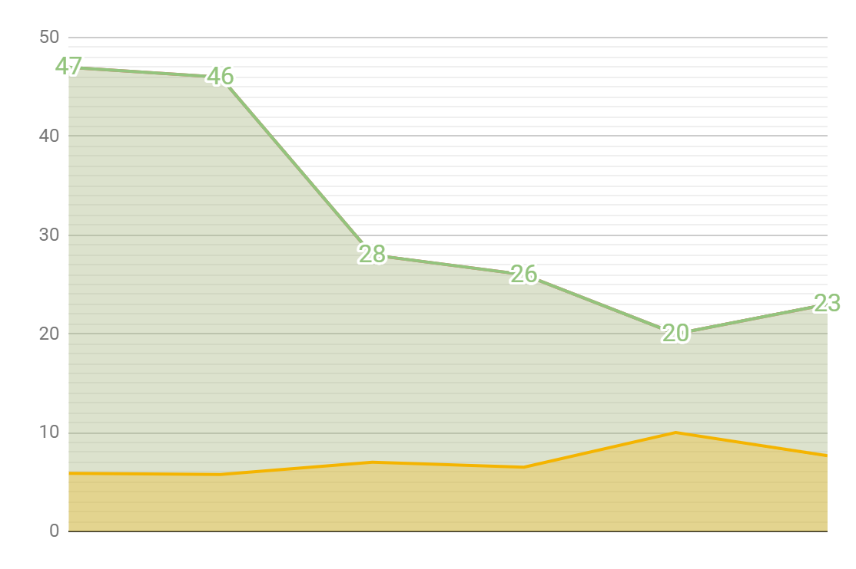
Velocity | Sprint | Sprint 1 | Sprint 2 | Sprint 3 | Sprint 4 | Sprint 5 | Sprint 6
 | Working Days | 8 | 8 | 4 | 4 | 2 | 3
4.166666667 | Planned Things | 5 | 7 | 2 | 3 | 5 | 3
31.66666667 | Planned Points | 47 | 46 | 28 | 26 | 20 | 23
4.166666667 | Finished Things | 5 | 7 | 2 | 3 | 5 | 3
31.66666667 | Finished Points | 47 | 46 | 28 | 26 | 20 | 23
7.13 | Points per dev day | 5.88 | 5.75 | 7.00 | 6.50 | 10.00 | 7.67
100% | Commit Score | 100% | 100% | 100% | 100% | 100% | 100%

Slide 53
System Demo

Slide 54
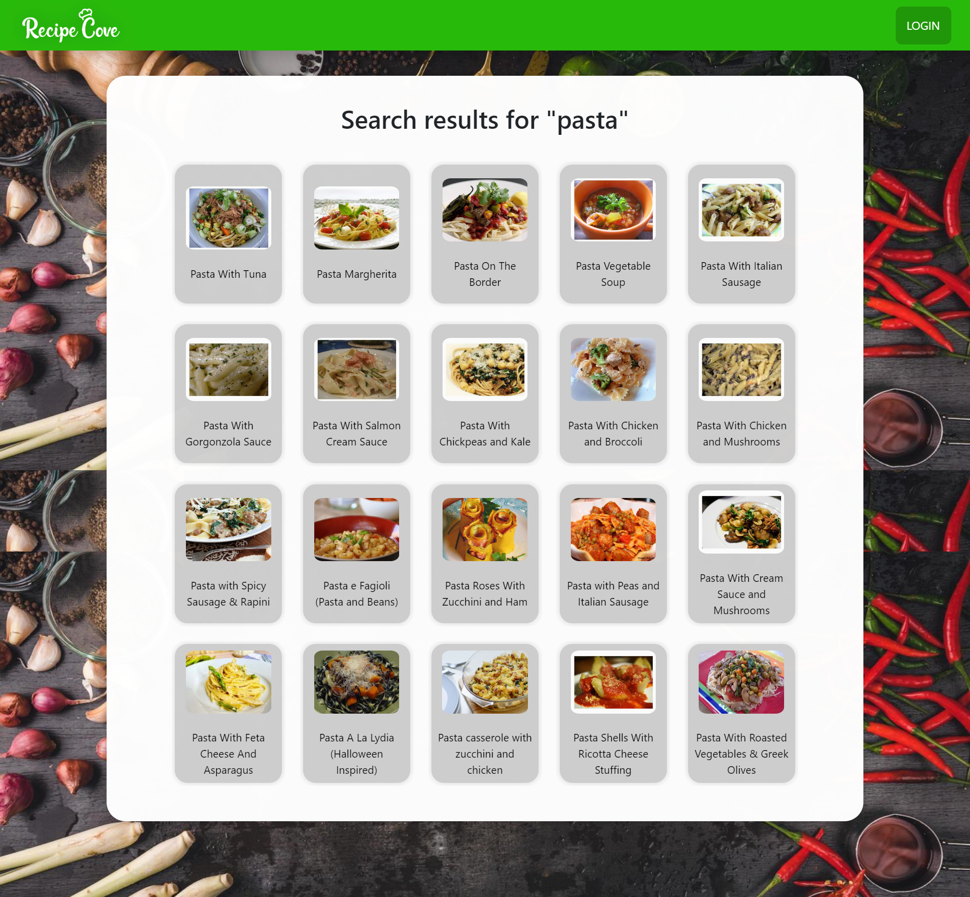
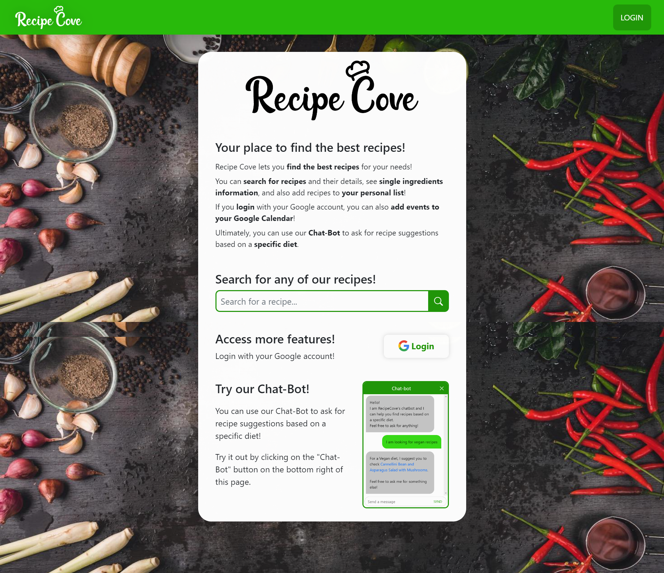

Slide 55
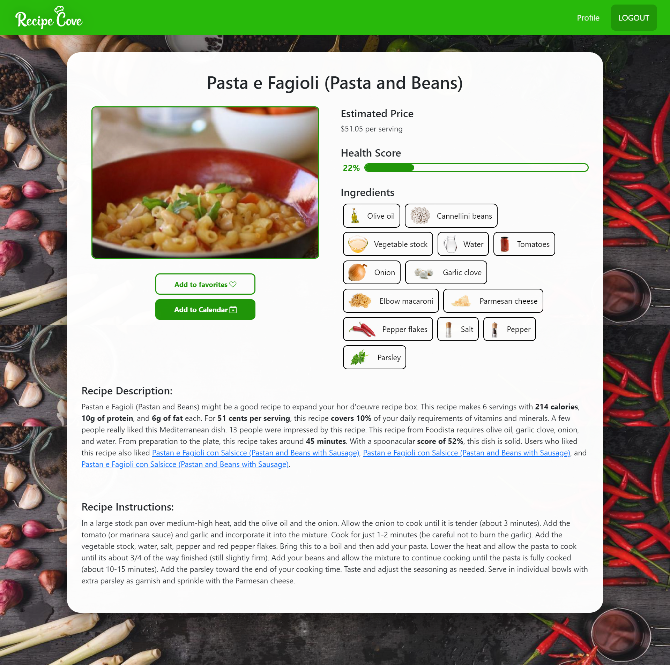
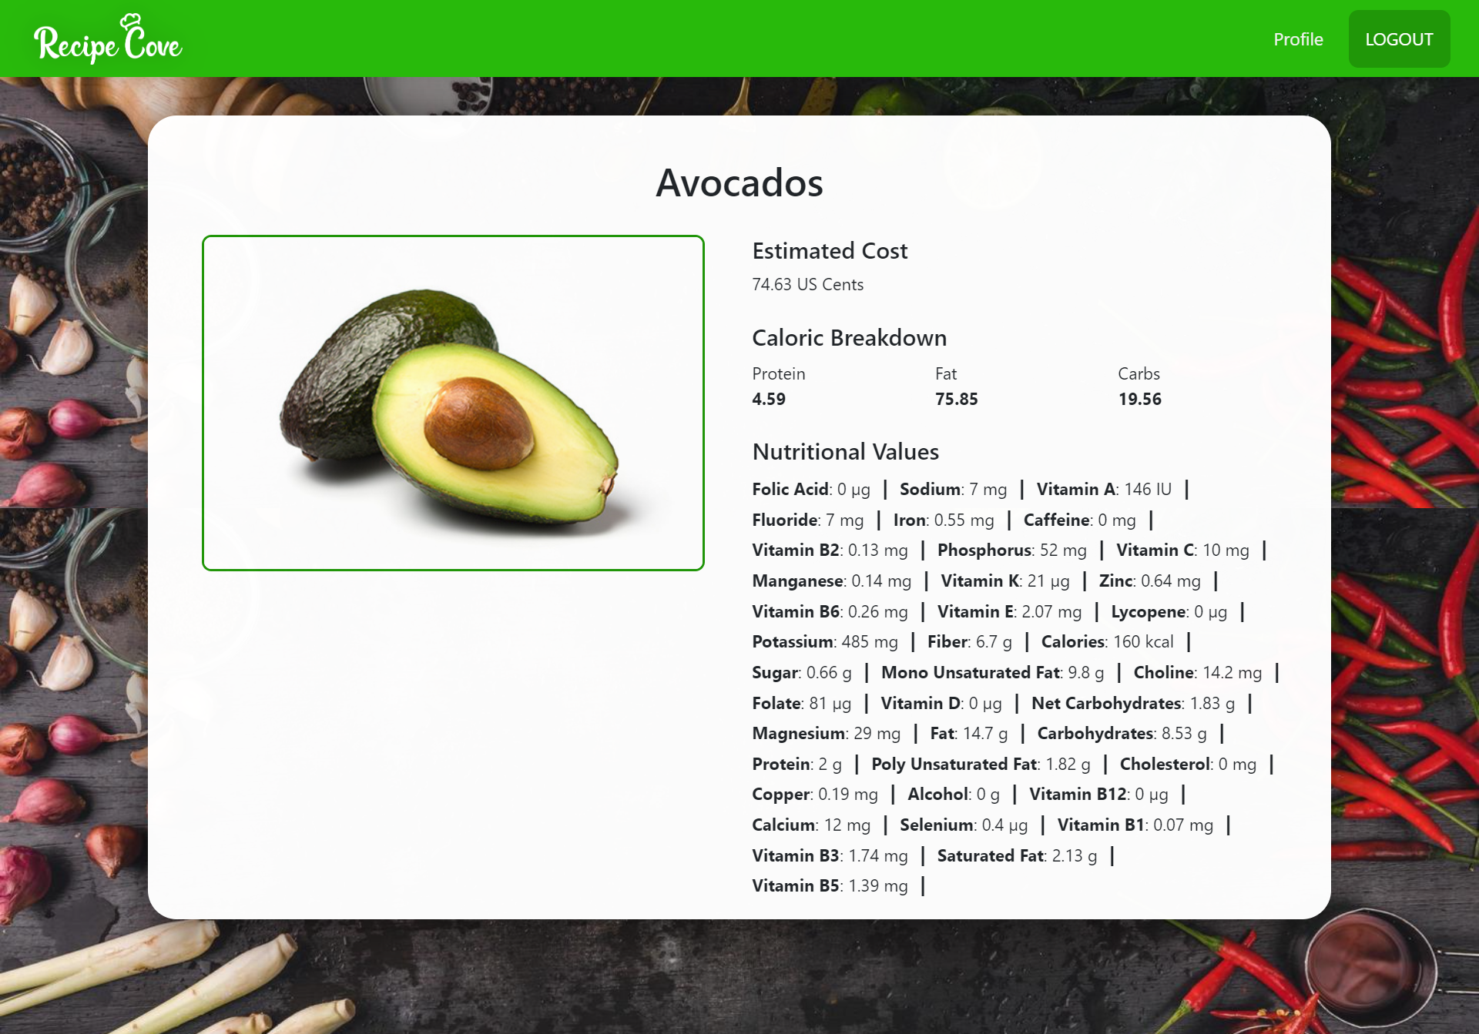

Slide 56
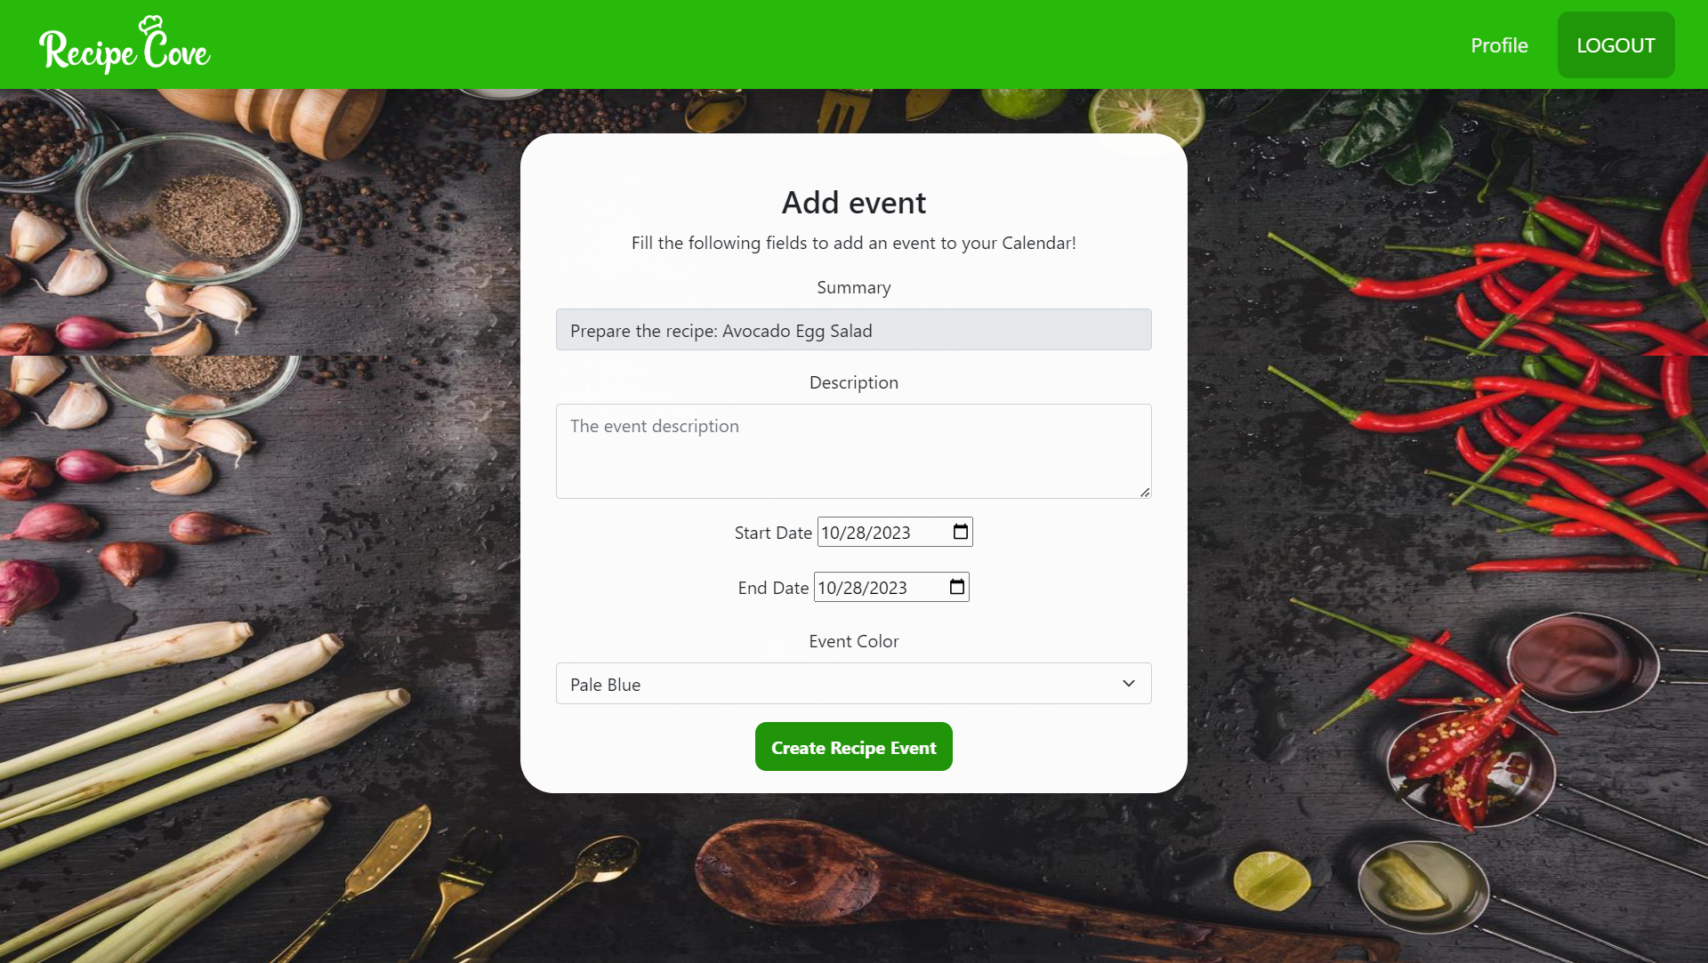
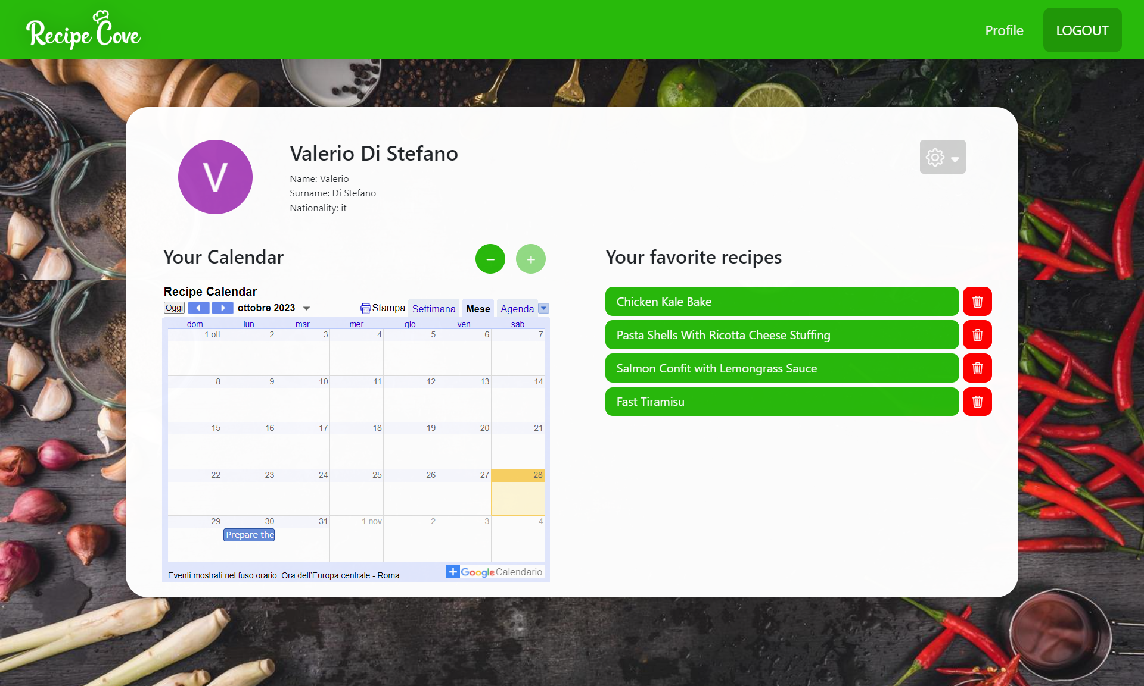
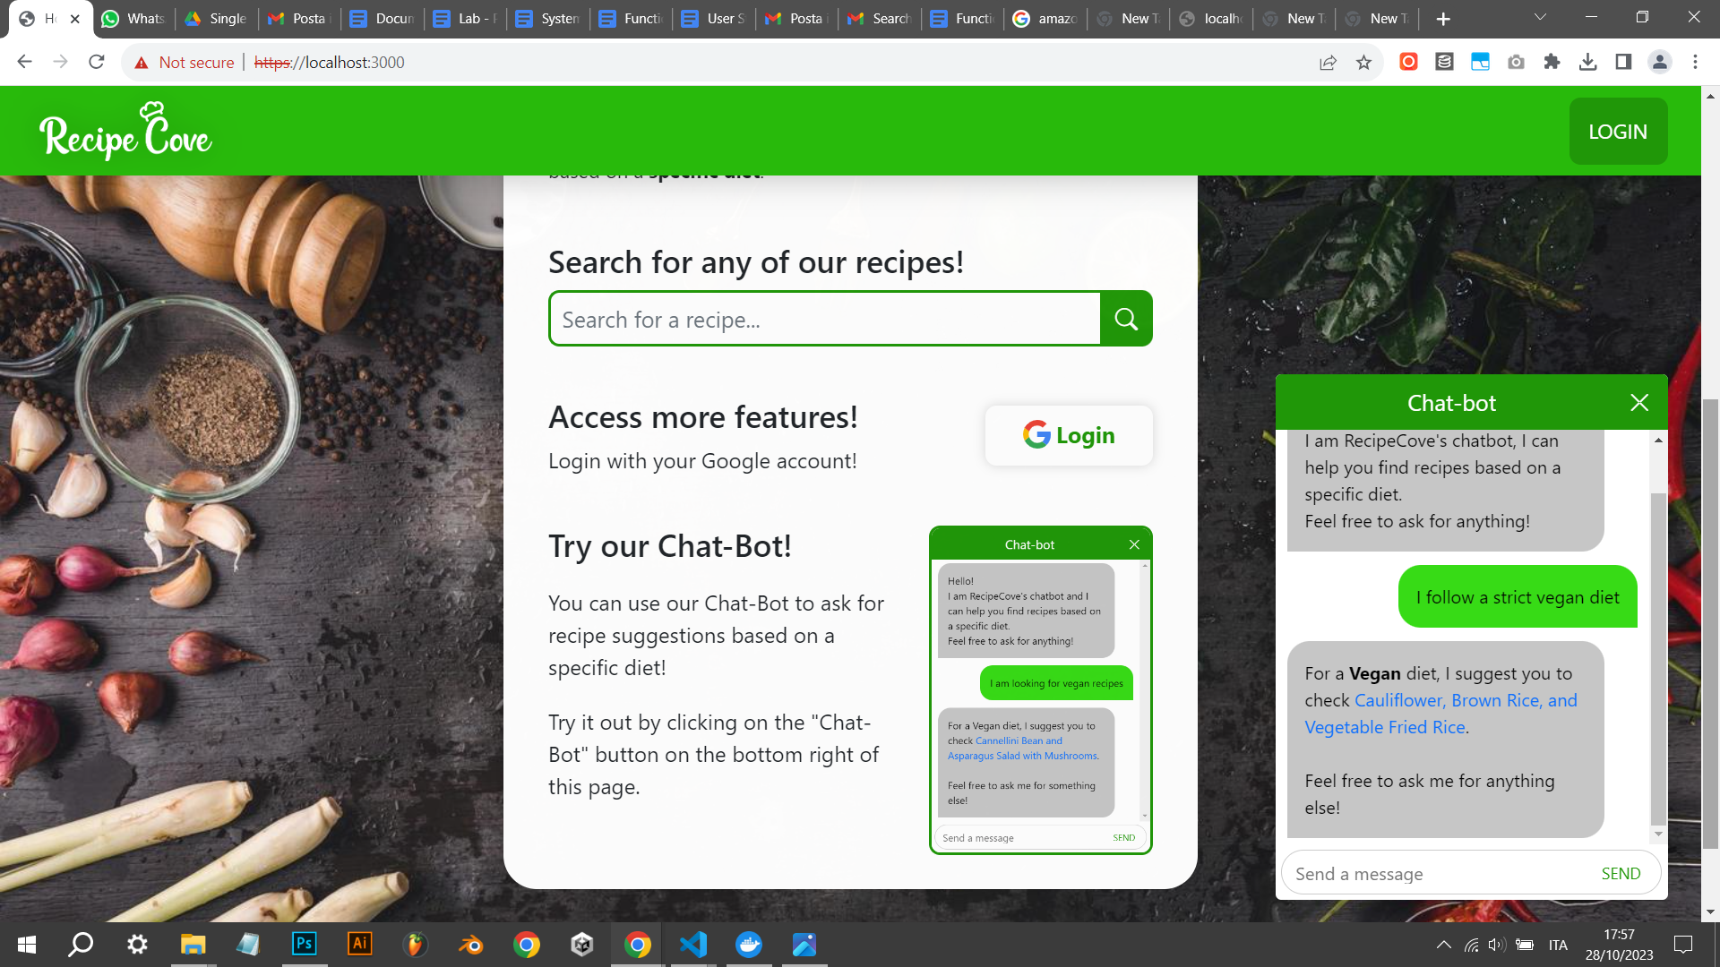

Slide 57

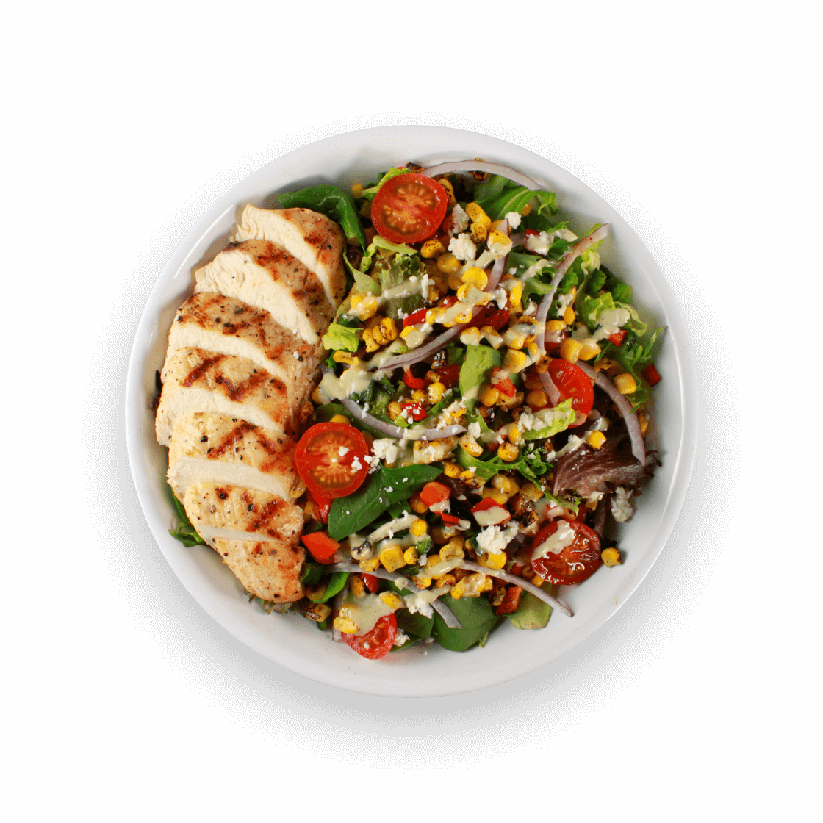
Project developed for the course of
Laboratory of Advanced Programming
at Sapienza University of Rome
Valerio Di Stefano
Giuseppe Prisco

